Slide 1

The Scrollers
SmartAttend: Powered by OnDemand Technology
Team Name : The Scrollers
Institute : JIET

Slide 2

The Scrollers
System Workflow:
Step 1: Teacher logs in using OnDemand authentication.
Step 2: Teacher uploads a class photo via the OnDemand platform.
Step 3: The OnDemand system performs real-time face recognition.
Step 4: Attendance is automatically marked using OnDemand access to the student database.
Step 5: Teachers can review and edit attendance records on the OnDemand dashboard.
2

Slide 3

Automated Attendance Marking
The Scrollers
1.Attendance Marking Process:
2.Once face recognition is complete, OnDemand agents automatically mark the students as "Present" or "Absent" based on the results.
3.Teachers can review the attendance.
4.Data Storage: Attendance records are stored in real-time in the OnDemand system.
3

Slide 4
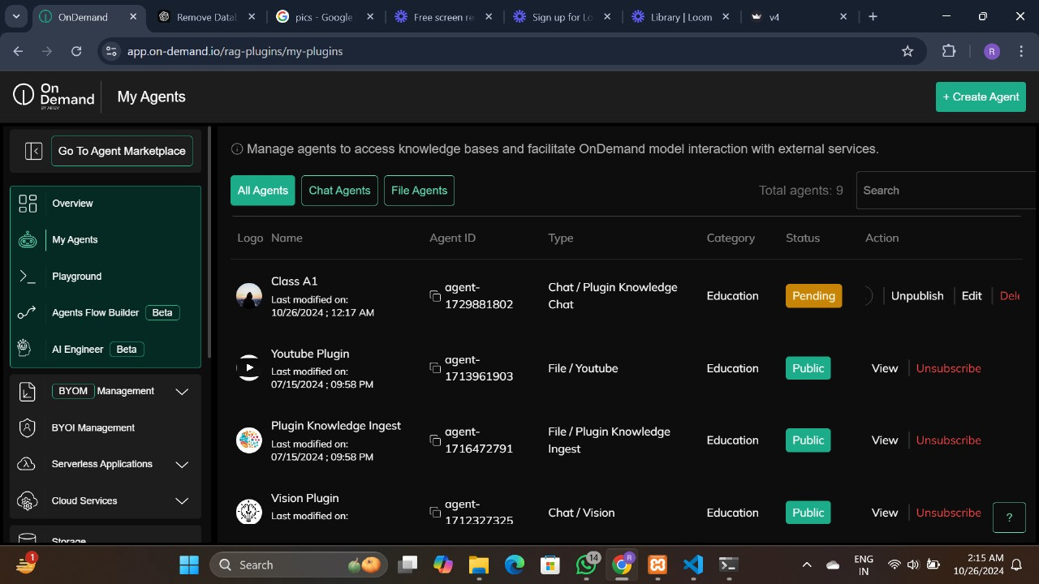
Using Agent:
The Scrollers
4

Slide 5
The Scrollers
System Benefits with OnDemand Agents:
Efficiency:
Real-Time Processing: OnDemand agents ensure that attendance is marked immediately after the photo upload.
Automation: Reduces manual effort, allowing teachers to focus on teaching rather than administrative tasks.
Accuracy:
OnDemand agents improve accuracy in face recognition, reducing errors in attendance marking.
They also provide insights into attendance patterns for teachers and administrators.
Scalability:
OnDemand agents handle multiple classrooms and large data volumes, ensuring scalability for institutions of any size.
Multi-classroom Support: Agents can be deployed across different classrooms simultaneously.
5

